Slide 1

Template 3
©Moonpreneur Inc. 2019

Slide 3
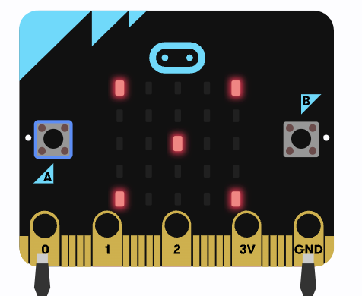
Digital Dice
Chinmayee Kambhampati

Slide 4
INTRODUCTION
Hello, I am Chinmayee. I am 7 years old. I am studying 2nd Grade in Millard Elementary School. I like to do coding in Makecode to do new projects.
©Moonpreneur Inc. 2019

Slide 5
PROJECT HIGHLIGHTS
One Digital Dice for all board games.
The Game will be fair.
©Moonpreneur Inc. 2019
Notes:
Sometimes you might want to turn your video on or off during a Zoom call.
Can you try to turn off your camera and turn on again?

Slide 6
SHOW AND TELL TOPIC
I am using Makecode to create my project Digital Dice
I used blocks like input, basic, logic in Makecode.
This project runs on Microbit.
Notes:
Can you unmute your mic one by one and shay hello?
If any of them is unable to do that, only then share your ppt and show them how to mute and unmute.

Slide 7
Show the project

Slide 8
Thank you for listening
©Moonpreneur Inc. 2019

